Slide 1
Introduction to sequencing microbiota
Spencer Glantz, Ph.D.
Postdoctoral Associate, Oh Lab
spencer.glantz@jax.org

Slide 2
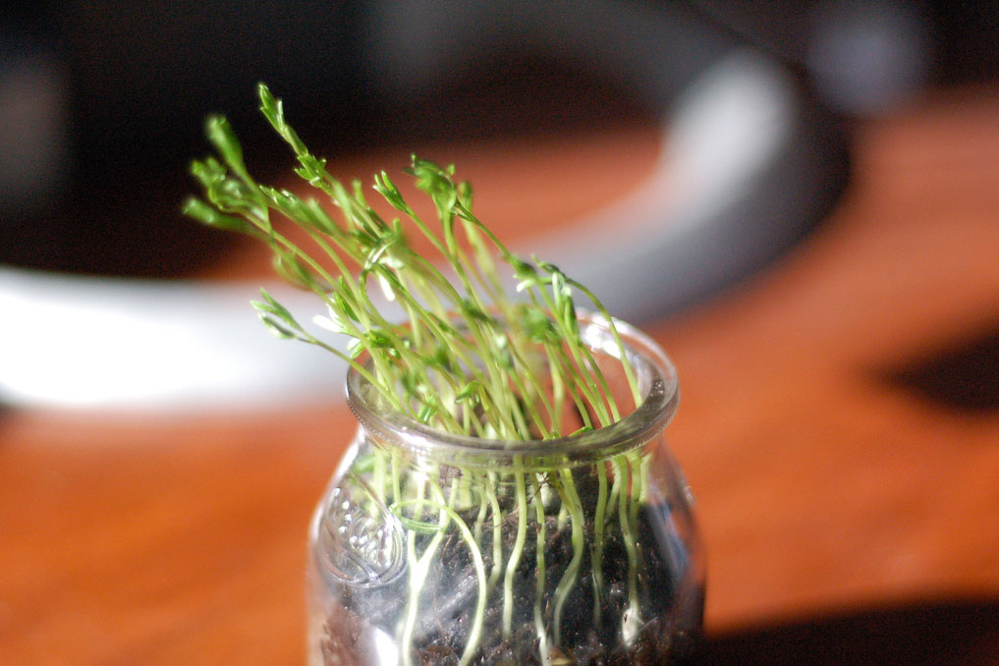
Notes:
Before we jump in, I just wanted to introduce myself and why I’m excited to be here today.
In my PhD, I was really fascinated by what’s going on in this picture – we’ve all seen plants curve towards the light and I wanted to study at the molecular level how this all works.
It turns out that there are photoreceptor proteins that detect light and initiate signaling cascades that cause plants to bend.
My advisor asked me to look at every gene for every sequenced organism and to predict new photoreceptors that have new functions….after one day of trying this manually, it was pretty clear I would have to learn to program.
I know exactly how you and your students feel but I also know it is totally possible to pick up these computational skills and apply them to biology.
It’s not a far leap from sequencing plants and fungi and bacteria to look for photoreceptos to wanting to sequence the microbiome, so I’ve moved to JAX, where there is high expertise in this field.

Slide 3
Big data to knowledge
Data science
Biological question
101010101000101010110101010010001001001001010101
New insights and hypotheses
→ Computational approaches can address biological questions nearly impossible to address in the wet lab alone…but having all the skills is challenging!
Notes:
And why are you here? All week we’ve been exposing you to a number of computational skills useful for managing, computing and visualizing big data as well as some examples of biological problems that require big data approaches (e.g. RNA seq, etc). Example: What genes are differentially expressed in yeast under high temperature - rather than look gene by gene with intensive wet lab methods, we can run an RNAseq pipeline to sort through and test thousands of genes simultaneously
And this is really hard! Because you need all these skills at the same time to make it though this analysis

Slide 4
Pedagogical strategy
Overall goal: Use bioinformatics technologies/techniques to deliver insight into a biological question of interest
First we’ll divide the overall goal into its component pieces:
What is the biology? How can we study it by sequencing?
What is a typical experimental & computational workflow?
What kind of biological insights can we derive?
How do we program at the command line?
Then we’ll try to put everything together
Synthesis: hands on module

Slide 5
1) What is the biology?
And how can we study it by sequencing?

Slide 6


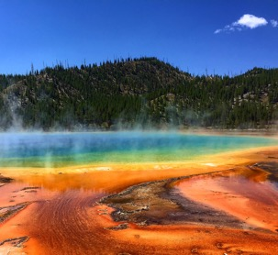
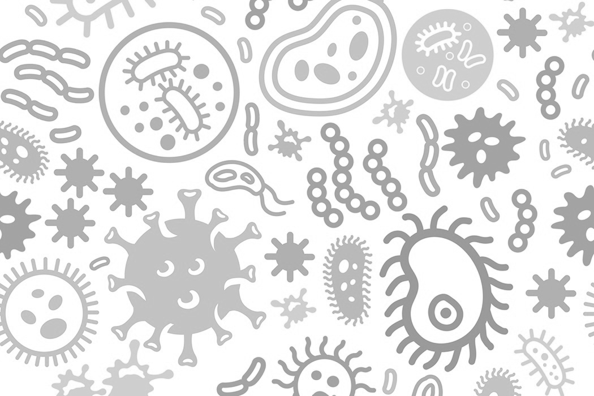


Microbial communities are all around
human epithelia
hot springs
soil
ocean
Upon a closer look…
Microbiome
fungi
viruses
bacteria
archaea
protists
micro-animals
Notes:
We’ve known this ever since the very first microscopes were built and trained on soil and water samples in the 1600s. But although we’ve been able to observe these microbial communities living in and on our body and water sources and soil and even in extreme environments as pictured in Yellowstone national park here, we are still grappling with basic questions about what microbes live where and what their roles are in maintaining the homeostasis of complex ecosystems.
WE WILL FOCUS ON HUMAN MICROBIOME

Slide 7
How do we identify members of microbiomes?

Slide 8
We need a “microbial fingerprint”
Fingerprints are both universally present on all people and unique
Notes:
When we think about our own literal fingerprints – what makes them useful especially for criminal investigations is that we all have a fingerprint, so it is a metric that can be universally applied, AND interestingly, we all have unique fingerprints, so we can systemically distinguish ourselves. What would the genetic equivalent be?

Slide 9
The 16S ribosomal RNA as a microbial fingerprint
Fingerprints are both universally present on all people and unique
The ribosome is essential for survival across all kingdoms of life and is thus highly conserved
polypeptide
mRNA
ribosome
Notes:
If we think about genes that are nearly universally present, one might think about the ribosome – which going back to cell biology, is the cellular machinery responsible for translating messenger RNA into polypeptide chains that comprise proteins. Since ribosomes are essential for survival, they are nearly universally present across microbes, - in biology we call that “highly conserved”

Slide 10
The 16S ribosomal RNA as a microbial fingerprint
Fingerprints are both universally present on all people and unique
Specifically, the 16S rRNA component of the ribosome is highly conserved among bacteria/archaea, yet contains hypervariable regions
23S rRNA
5S rRNA
31 proteins
50s
16S rRNA
21 proteins
30s
ribosome
Notes:
For a fingerprint to be useful, it also has to be unique. Interestingly, if we zoom in on the structure of the ribosome we can see that it is comprised of two discrete subunits, each of which is a mix of ribosomal RNA and protein. Among the RNAs is the 16s RNA, which as a ribosomal structural component is highly conserved, and yet, contains hypervariable regions that differ such that different species have different characteristic 16s sequences. We can actually use the differences

Slide 11
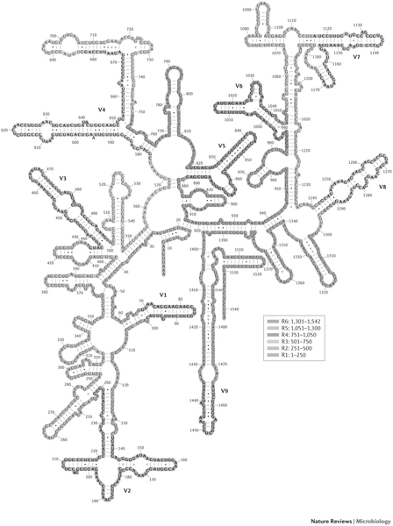
Hypervariable 16S regions can be used for species identification
16S rRNA secondary structure
16S rRNA contains 9 variable regions
conserved region (non-specific)
V6
V7
V4
variable region (species-specific)
1500 bp
V5
V3
1
2
3
4
5
6
7
8
9
V8
V1
→ More distantly related species exhibit more divergent 16S RNA sequences
V2
Notes:
Figure 2. J Invest Dermatol. 2016 Mar; 136(3): e23–e27. Bacterial 16S ribosomal RNA gene sequencing in cutaneous research. Jay-Hyun Jo, Postdoctoral Fellow, Elizabeth A. Kennedy, Post-baccalaureate Fellow, and Heidi H. Kong, Investigator
http://help.bioiplug.com/16s-rrna-and-16s-rrna-gene/
https://www.illumina.com/documents/products/appnotes/appnote_miseq_16S.pdf
https://www.pacb.com/wp-content/uploads/Jethro-Johnson-PacBio-East-Coast-UGM-2017.pdf

Slide 12
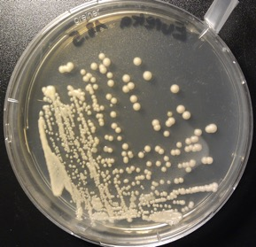
Microbial genomics suffers from lack of cultivation approaches
Isolate
Genomics
“The estimate that fewer than 1% of the prokaryotes in most environments can be cultivated in isolation has produced a quandary: what is the significance of the field of modern microbial genomics if it is limited to culturable organisms?”
Schloss et al, Genome Biology, 2005

Slide 13
Metagenomics has revolutionized microbiome studies
Isolate
Genomics
Direct sequencing
Metagenomics
BIG data
Notes:
This perspective was likely reinforned by traditional genomics which focused on culturing and studying individual islates this completely missed the vast majority of species that cant be cultured and – Sequencing technology has recvolutionized our ability – instead ofculturing and studying individual isolates , metagenomics has enabled us to look at entire communities of bacteria (most of whichboth on heatlhy and diseased and its clear that there are no clear bad and good apples – we’ve learned that as a community, microbes actrually play diverse roles
High throughput, cheaper, more thoughout accounting
Preiously bottleneck - focus on culturing pathogens from sick patietns -> bacteira -> disease
Now can quickly map all -> applied to healthy and found pathogens!

Slide 14
The human microbiome by the numbers
10,000
360x
1-3%
10x
microbial
human
of body
weight
# of cells
unique
species
protein-coding
genes
What are all these microbes doing??
Notes:
We’ve known this ever since the very first microscopes were built and trained on soil and water samples in the 1600s. But although we’ve been able to observe these microbial communities living in and on our body and water sources and soil and even in extreme environments as pictured in Yellowstone national park here, we are still grappling with basic questions about what microbes live where and what their roles are in maintaining the homeostasis of complex ecosystems.

Slide 15
As a community, microbes actually play diverse physiological roles
Health roles
Pathogen resistance
Human microbiome
Biosynthesis of
Vitamins + anti-inflammatories
Develop & train
Immune system
Bone density
modulation
Metabolism of our diet
Mental health?
Notes:
Studies have shown that the microbiome is not only complex but also dynamic – with some of the key impacting factors listed here. We know that the microbiome is relatively stable, but can dramatically change after a course of antibiotics, or moving to a new country. Yet, behind every arrow here are dozens of big scientific questions waiting to be addressed.
Nutr Clin Pract. 2015 Dec;30(6):734-46. doi: 10.1177/0884533615609899. Epub 2015 Oct 8. Gut Microbiome: What We Do and Don't Know.
https://labiotech.eu/microbiome-therapies-seres-ser009/

Slide 16
As a community, microbes actually play diverse physiological roles
Health roles
Pathogen resistance
Human microbiome
Biosynthesis of
Vitamins + anti-inflammatories
Do we all have the same microbiome?
Develop & train
Immune system
Bone density
modulation
Metabolism of our diet
Mental health?
Notes:
Studies have shown that the microbiome is not only complex but also dynamic – with some of the key impacting factors listed here. We know that the microbiome is relatively stable, but can dramatically change after a course of antibiotics, or moving to a new country. Yet, behind every arrow here are dozens of big scientific questions waiting to be addressed.
Nutr Clin Pract. 2015 Dec;30(6):734-46. doi: 10.1177/0884533615609899. Epub 2015 Oct 8. Gut Microbiome: What We Do and Don't Know.
https://labiotech.eu/microbiome-therapies-seres-ser009/

Slide 17
The human microbiome is dynamic
Health roles
Some impacting factors
Pathogen resistance
Diet
Human microbiome
Biosynthesis of
Vitamins + anti-inflammatories
Birth and infant
feeding methods
Develop & train
Immune system
Stress
Bone density
modulation
Medical
intervention
Metabolism of our diet
Geography
Mental health?
Notes:
Studies have shown that the microbiome is not only complex but also dynamic – with some of the key impacting factors listed here. We know that the microbiome is relatively stable, but can dramatically change after a course of antibiotics, or moving to a new country. Yet, behind every arrow here are dozens of big scientific questions waiting to be addressed.
Nutr Clin Pract. 2015 Dec;30(6):734-46. doi: 10.1177/0884533615609899. Epub 2015 Oct 8. Gut Microbiome: What We Do and Don't Know.
https://labiotech.eu/microbiome-therapies-seres-ser009/

Slide 18
How can we better understand our microbiomes? 2) What is a typical experimental & computational workflow?
Notes:
Studies have shown that the microbiome is not only complex but also dynamic – with some of the key impacting factors listed here. We know that the microbiome is relatively stable, but can dramatically change after a course of antibiotics, or moving to a new country. Yet, behind every arrow here are dozens of big scientific questions waiting to be addressed.
Nutr Clin Pract. 2015 Dec;30(6):734-46. doi: 10.1177/0884533615609899. Epub 2015 Oct 8. Gut Microbiome: What We Do and Don't Know.
https://labiotech.eu/microbiome-therapies-seres-ser009/

Slide 19
Key elements of a microbiome study
Develop your question
Choose study subjects
Analyze microbial composition & diversity
Collect samples
Glean new biological insights
Goodrich et al, Cell (2014)
Notes:
How can we experimentally probe the microbiome? One of the key questions researchers want to address is – who is there? What microorganisms – especially bacteria – are present where in the human body – how are they grouped? And how do they help to promote or resist disease?
Nutr Clin Pract. 2015 Dec;30(6):734-46. doi: 10.1177/0884533615609899. Epub 2015 Oct 8. Gut Microbiome: What We Do and Don't Know.
https://labiotech.eu/microbiome-therapies-seres-ser009/

Slide 20
Key elements of a microbiome study
Develop your question
Choose study subjects
Analyze microbial composition & diversity
Collect samples
Glean new biological insights
Goodrich et al, Cell (2014)
Notes:
How can we experimentally probe the microbiome? One of the key questions researchers want to address is – who is there? What microorganisms – especially bacteria – are present where in the human body – how are they grouped? And how do they help to promote or resist disease?
Nutr Clin Pract. 2015 Dec;30(6):734-46. doi: 10.1177/0884533615609899. Epub 2015 Oct 8. Gut Microbiome: What We Do and Don't Know.
https://labiotech.eu/microbiome-therapies-seres-ser009/

Slide 21
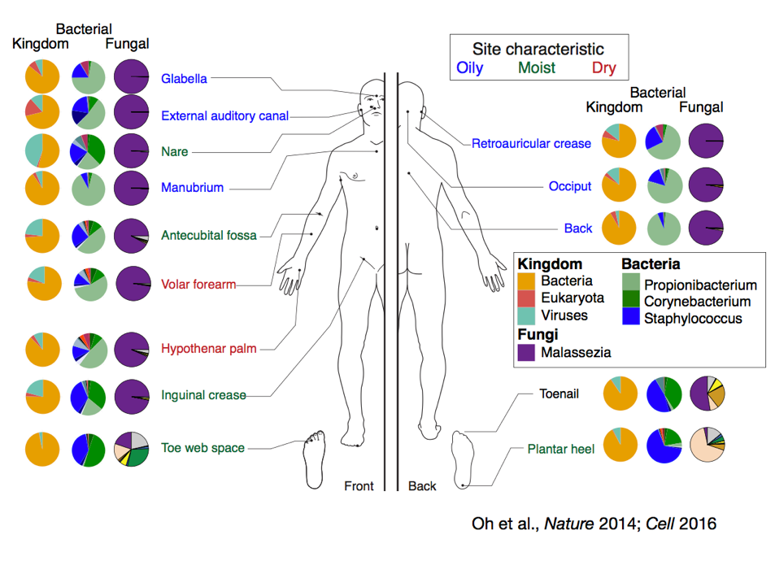
Studies can be descriptive
How do bacterial communities differ depending on the physical characteristics of different body sites?
Notes:
Descriptive studies are observational studies which describe the patterns of disease occurrence in relation to variables such as person, place and time. They are often the first step or initial enquiry into a new topic, event, disease or condition.
Nutr Clin Pract. 2015 Dec;30(6):734-46. doi: 10.1177/0884533615609899. Epub 2015 Oct 8. Gut Microbiome: What We Do and Don't Know.
https://labiotech.eu/microbiome-therapies-seres-ser009/

Slide 22
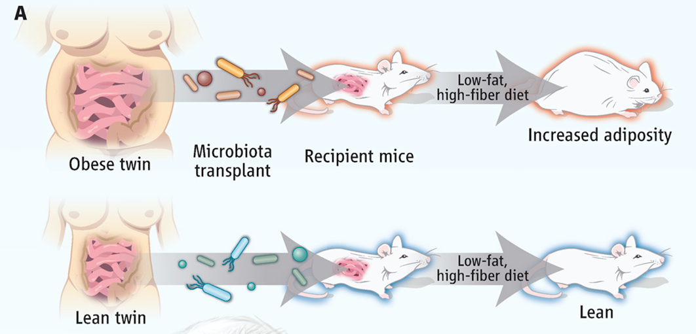
Or studies can be case-control
What happens to germ-free mice fed a consistent diet, but transplanted with microbiota from lean v. obese donors?
Walker and Parkhill, Science, 2013
Notes:
A study that compares patients who have a disease or outcome of interest (cases) with patients who do not have the disease or outcome (controls), and looks back retrospectively to compare how frequently the exposure to a risk factor is present in each group to determine the relationship between the risk factor and the ...
Nutr Clin Pract. 2015 Dec;30(6):734-46. doi: 10.1177/0884533615609899. Epub 2015 Oct 8. Gut Microbiome: What We Do and Don't Know.
https://labiotech.eu/microbiome-therapies-seres-ser009/

Slide 23
What biological questions can we address with our big data approach?
Notes:
How can we experimentally probe the microbiome? One of the key questions researchers want to address is – who is there? What microorganisms – especially bacteria – are present where in the human body – how are they grouped? And how do they help to promote or resist disease?
Nutr Clin Pract. 2015 Dec;30(6):734-46. doi: 10.1177/0884533615609899. Epub 2015 Oct 8. Gut Microbiome: What We Do and Don't Know.
https://labiotech.eu/microbiome-therapies-seres-ser009/

Slide 24
A sampling of microbiome questions
What microbes live where?
What drives resilience of a microbiome and enables resistance to change?
How do microbes interact with the host (e.g. immune system)?
How does microbiome composition affect microbiome function?
Are changes in the microbiome causative of disease or result from disease or both?
Notes:
How can we experimentally probe the microbiome? One of the key questions researchers want to address is – who is there? What microorganisms – especially bacteria – are present where in the human body – how are they grouped? And how do they help to promote or resist disease?
Nutr Clin Pract. 2015 Dec;30(6):734-46. doi: 10.1177/0884533615609899. Epub 2015 Oct 8. Gut Microbiome: What We Do and Don't Know.
https://labiotech.eu/microbiome-therapies-seres-ser009/

Slide 25
Key elements of a microbiome study
Develop your question
Choose study subjects
Analyze microbial composition & diversity
Collect samples
Glean new biological insights
Humans
Mice, conventional
Mice, germ-free
Mice, antibiotic
Goodrich et al, Cell (2014)
Notes:
How can we experimentally probe the microbiome? One of the key questions researchers want to address is – who is there? What microorganisms – especially bacteria – are present where in the human body – how are they grouped? And how do they help to promote or resist disease?
Nutr Clin Pract. 2015 Dec;30(6):734-46. doi: 10.1177/0884533615609899. Epub 2015 Oct 8. Gut Microbiome: What We Do and Don't Know.
https://labiotech.eu/microbiome-therapies-seres-ser009/

Slide 26
Key elements of a microbiome study
Develop your question
Choose study subjects
Analyze microbial composition & diversity
Collect samples
Glean new biological insights
Humans
Mice, conventional
Mice, germ-free
Mice, antibiotic
How many subjects do we need?
Goodrich et al, Cell (2014)
Notes:
How can we experimentally probe the microbiome? One of the key questions researchers want to address is – who is there? What microorganisms – especially bacteria – are present where in the human body – how are they grouped? And how do they help to promote or resist disease?
Nutr Clin Pract. 2015 Dec;30(6):734-46. doi: 10.1177/0884533615609899. Epub 2015 Oct 8. Gut Microbiome: What We Do and Don't Know.
https://labiotech.eu/microbiome-therapies-seres-ser009/

Slide 27
Sample size is related to our ability to make a claim
→ Example: Is this coin biased or not?
4 flips: 2 heads, 2 tails
1000 flips: 333 heads, 667 tails
Notes:
How can we experimentally probe the microbiome? One of the key questions researchers want to address is – who is there? What microorganisms – especially bacteria – are present where in the human body – how are they grouped? And how do they help to promote or resist disease?
Nutr Clin Pract. 2015 Dec;30(6):734-46. doi: 10.1177/0884533615609899. Epub 2015 Oct 8. Gut Microbiome: What We Do and Don't Know.
https://labiotech.eu/microbiome-therapies-seres-ser009/

Slide 28
Sample size is related to our ability to make a claim
→ Example: Is this coin biased or not?
4 flips: 2 heads, 2 tails
1000 flips: 333 heads, 667 tails
4 flips: 1 heads, 3 tails
1000 flips: 492 heads, 508 tails
Notes:
How can we experimentally probe the microbiome? One of the key questions researchers want to address is – who is there? What microorganisms – especially bacteria – are present where in the human body – how are they grouped? And how do they help to promote or resist disease?
Nutr Clin Pract. 2015 Dec;30(6):734-46. doi: 10.1177/0884533615609899. Epub 2015 Oct 8. Gut Microbiome: What We Do and Don't Know.
https://labiotech.eu/microbiome-therapies-seres-ser009/

Slide 29
Sample size is related to our ability to make a claim
• Sample size = # of subjects (e.g. number of individual coin flips)
• Null hypothesis = hypothesis that there is no difference from the expected mean (e.g. fair coin)
• Statistical power = ability to detect a true difference from the null hypothesis – depends in part on the sample size (e.g. can we actually discover when a coin is not fair?)
Sample size
Statistical power
Notes:
How can we experimentally probe the microbiome? One of the key questions researchers want to address is – who is there? What microorganisms – especially bacteria – are present where in the human body – how are they grouped? And how do they help to promote or resist disease?
Nutr Clin Pract. 2015 Dec;30(6):734-46. doi: 10.1177/0884533615609899. Epub 2015 Oct 8. Gut Microbiome: What We Do and Don't Know.
https://labiotech.eu/microbiome-therapies-seres-ser009/

Slide 30
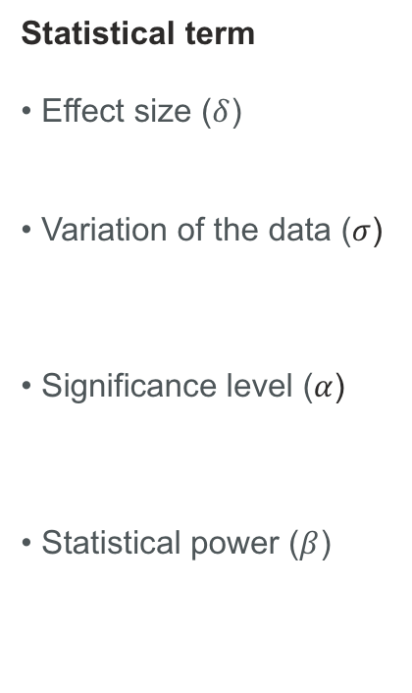
Study design
There are 4 parameters that will help us determine our required sample size to ensure that we observe a certain experimental effect with high probability:
Coin flip analogy
• How weighted is the coin? (55% heads or 90% heads)
• How far does the result typically deviate from 50% heads?
• What should be our tolerance for saying the coin is biased when it actually isn’t? (5%)
• To what degree do we want to be able to detect a biased coin when it is actually biased? (80%)
Statistical term
• Effect size ($δ$)
• Variation of the data ($σ$)
• Significance level ($α$)
• Statistical power ($β$)
Sample size needed
Notes:
How can we experimentally probe the microbiome? One of the key questions researchers want to address is – who is there? What microorganisms – especially bacteria – are present where in the human body – how are they grouped? And how do they help to promote or resist disease?
Nutr Clin Pract. 2015 Dec;30(6):734-46. doi: 10.1177/0884533615609899. Epub 2015 Oct 8. Gut Microbiome: What We Do and Don't Know.
https://labiotech.eu/microbiome-therapies-seres-ser009/

Slide 31
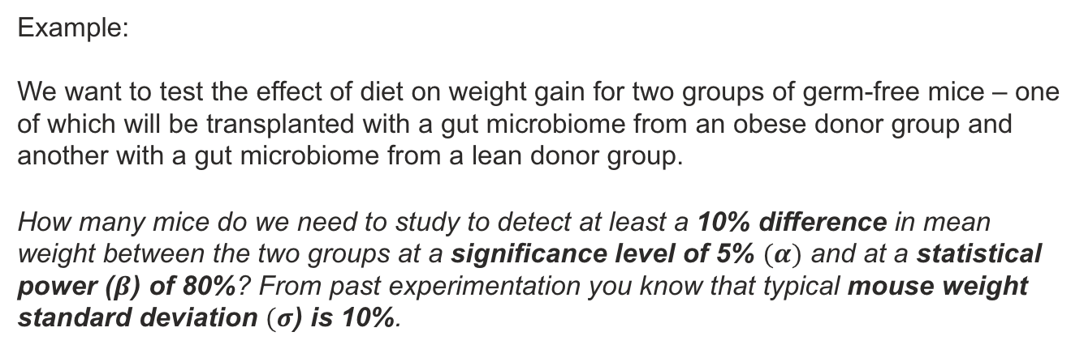
Study design
Example:
We want to test the effect of diet on weight gain for two groups of germ-free mice – one of which will be transplanted with a gut microbiome from an obese donor group and another with a gut microbiome from a lean donor group.
How many mice do we need to study to detect at least a 10% difference in mean weight between the two groups at a significance level of 5% $(α)$ and at a statistical power ($β$) of 80%? From past experimentation you know that typical mouse weight standard deviation $(σ$) is 10%.
Notes:
http://www.stat.wisc.edu/~st571-1/10-power-2.pdf
https://www.thomasjpfan.com/2015/08/statistical-power-of-coin-flips/
https://www.vumc.org/cqs/files/cqs/public_files/media/2008Mar2008Shintani.pdf
http://statweb.stanford.edu/~susan/courses/s141/hopower.pdf

Slide 32
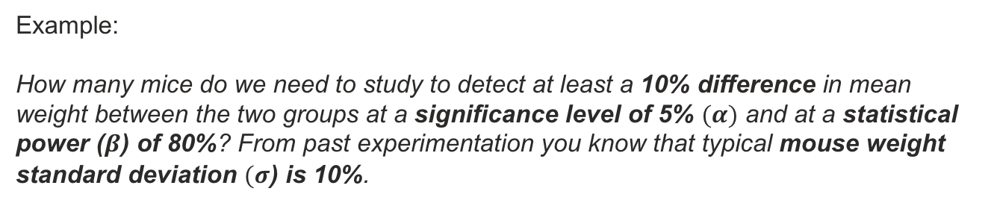

Study design
Example:
How many mice do we need to study to detect at least a 10% difference in mean weight between the two groups at a significance level of 5% $(α)$ and at a statistical power ($β$) of 80%? From past experimentation you know that typical mouse weight standard deviation $(σ$) is 10%.
(1) Compute the effect size:
$$E\text{ffect} \text{size}\text{ (}δ) \text{=}\frac{\text{Variation} \text{between} \text{groups}}{\text{Random} \text{variation}}=\frac{\text{mean} \text{difference}}{\text{standard} \text{deviation}}= \frac{μ−μ_{0}}{σ}$$
$$\text{Effect} \text{size}\text{ (}δ) \text{= }\frac{0.1}{0.1}=1$$
Notes:
http://www.stat.wisc.edu/~st571-1/10-power-2.pdf
https://www.thomasjpfan.com/2015/08/statistical-power-of-coin-flips/
https://www.vumc.org/cqs/files/cqs/public_files/media/2008Mar2008Shintani.pdf
http://statweb.stanford.edu/~susan/courses/s141/hopower.pdf

Slide 33
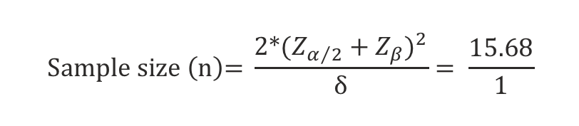
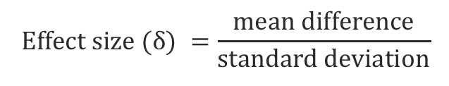
Study design
Example:
How many mice do we need to study to detect at least a 10% difference in mean weight between the two groups at a significance level of 5% $(α)$ and at a statistical power ($β$) of 80%? From past experimentation you know that typical mouse weight standard deviation $(σ$) is 10%.
(1) Compute the effect size:
$$E\text{ffect} \text{size}\text{ (}δ) =\frac{\text{mean} \text{difference}}{\text{standard} \text{deviation}}$$
$$\text{Effect} \text{size}\text{ (}δ) \text{= }\frac{0.1}{0.1}=1$$
(2) Compute the required sample size*:
$$\text{Sample} \text{size} \left(\text{n}\right)\text{= }\frac{{\text{2∗}\text{(}Z_{α/2}+Z_{β})}^{2}}{\text{δ}}= \frac{15.68}{1}$$
You will need at least 16 mice per group
*assumes normally distributed data
Notes:
http://www.stat.wisc.edu/~st571-1/10-power-2.pdf
https://www.thomasjpfan.com/2015/08/statistical-power-of-coin-flips/
https://www.vumc.org/cqs/files/cqs/public_files/media/2008Mar2008Shintani.pdf
http://statweb.stanford.edu/~susan/courses/s141/hopower.pdf

Slide 34
Study design
Example:
How many mice do we need to study to detect at least a 10% difference in mean weight between the two groups at a significance level of 5% $(α)$ and at a statistical power ($β$) of 80%? From past experimentation you know that typical mouse weight standard deviation $(σ$) is 10%.
A Z test gives critical values for each significance level assuming normally distributed data around a mean of 0
Example:
Z_{0.025} = 1.96
For data normally distributed around 0, only 2.5% of the values will be greater than 1.96
(1) Compute the effect size:
$$E\text{ffect} \text{size}\text{ (}δ) =\frac{\text{mean} \text{difference}}{\text{standard} \text{deviation}}$$
$$\text{Effect} \text{size}\text{ (}δ) \text{= }\frac{0.1}{0.1}=1$$
(2) Compute the required sample size*:
$$\text{Sample} \text{size} \left(\text{n}\right)\text{= }\frac{{\text{2∗}\text{(}Z_{α/2}+Z_{β})}^{2}}{\text{δ}}= \frac{15.68}{1}$$
You will need at least 16 mice per group
*assumes normally distributed data
Notes:
http://www.stat.wisc.edu/~st571-1/10-power-2.pdf
https://www.thomasjpfan.com/2015/08/statistical-power-of-coin-flips/
https://www.vumc.org/cqs/files/cqs/public_files/media/2008Mar2008Shintani.pdf
http://statweb.stanford.edu/~susan/courses/s141/hopower.pdf

Slide 35
Study design
Notes:
http://www.stat.wisc.edu/~st571-1/10-power-2.pdf
https://www.thomasjpfan.com/2015/08/statistical-power-of-coin-flips/
https://www.vumc.org/cqs/files/cqs/public_files/media/2008Mar2008Shintani.pdf
http://statweb.stanford.edu/~susan/courses/s141/hopower.pdf

Slide 36
Study design
Develop your question
Choose study subjects
Analyze microbial composition & diversity
Glean new biological insights
Collect samples
Taxonomic analysis
Diversity analysis
Visualize results
Notes:
How can we experimentally probe the microbiome? One of the key questions researchers want to address is – who is there? What microorganisms – especially bacteria – are present where in the human body – how are they grouped? And how do they help to promote or resist disease?
Nutr Clin Pract. 2015 Dec;30(6):734-46. doi: 10.1177/0884533615609899. Epub 2015 Oct 8. Gut Microbiome: What We Do and Don't Know.
https://labiotech.eu/microbiome-therapies-seres-ser009/

Slide 37
A workflow for 16S analysis
1
Collect sample
(e.g. skin swab)
Notes:
http://learn.genetics.utah.edu/content/microbiome/intro/
https://www.theatlantic.com/technology/archive/2012/11/what-dna-actually-looks-like/265713/

Slide 38

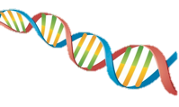

A workflow for 16S analysis
1
Collect sample
(e.g. skin swab)
2
Total DNA
extraction
Notes:
http://learn.genetics.utah.edu/content/microbiome/intro/
https://www.theatlantic.com/technology/archive/2012/11/what-dna-actually-looks-like/265713/

Slide 39
A workflow for 16S analysis
1
Collect sample
(e.g. skin swab)
2
Total DNA
extraction
3
Amplify variable region
of 16S rRNA gene
V4
Notes:
http://learn.genetics.utah.edu/content/microbiome/intro/
https://www.theatlantic.com/technology/archive/2012/11/what-dna-actually-looks-like/265713/

Slide 40
A workflow for 16S analysis
1
Collect sample
(e.g. skin swab)
2
Total DNA
extraction
3
Amplify variable region
of 16S rRNA gene
V4
4
Sequence 16S
rRNA genes
Read 1
Read 2
Notes:
http://learn.genetics.utah.edu/content/microbiome/intro/
https://www.theatlantic.com/technology/archive/2012/11/what-dna-actually-looks-like/265713/

Slide 41
A workflow for 16S analysis
1
Collect sample
(e.g. skin swab)
2
Total DNA
extraction
3
Amplify variable region
of 16S rRNA gene
V4
Sequence 16S
rRNA genes
Processing, QC, and assembly
of reads
4
5
Read 1
Read 2
Notes:
http://learn.genetics.utah.edu/content/microbiome/intro/
https://www.theatlantic.com/technology/archive/2012/11/what-dna-actually-looks-like/265713/

Slide 42
A workflow for 16S analysis
1
Collect sample
(e.g. skin swab)
2
Total DNA
extraction
3
Amplify variable region
of 16S rRNA gene
V4
Sequence 16S
rRNA genes
Processing, QC, and assembly
of reads
Generate a representative sequence for each species and assign taxonomy
4
5
6
Read 1
Read 2
Notes:
http://learn.genetics.utah.edu/content/microbiome/intro/
https://www.theatlantic.com/technology/archive/2012/11/what-dna-actually-looks-like/265713/

Slide 43
A workflow for 16S analysis
1
Collect sample
(e.g. skin swab)
2
Total DNA
extraction
3
Amplify variable region
of 16S rRNA gene
V4
Sequence 16S
rRNA genes
Processing, QC, and assembly
of reads
Generate a representative sequence for each species and assign taxonomy
4
5
6
Read 1
Read 2
relative abundance plot
diversity plot
Typical output →
Who? How much?
abundance
diversity
healthy
diseased
healthy
diseased
Notes:
http://learn.genetics.utah.edu/content/microbiome/intro/
https://www.theatlantic.com/technology/archive/2012/11/what-dna-actually-looks-like/265713/

Slide 44
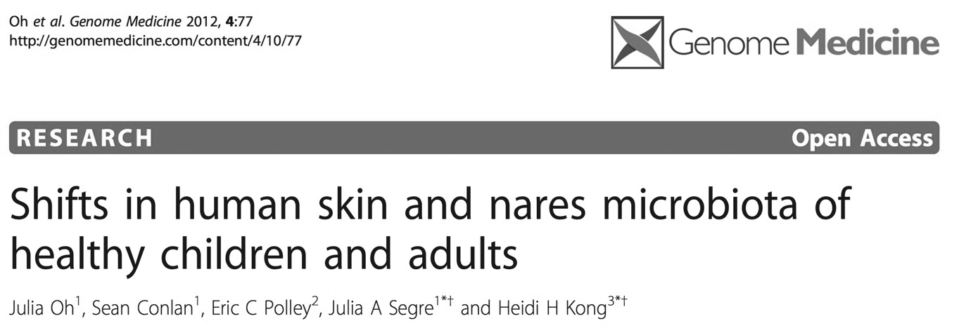
A real world 16S application
Question: How does the skin microbiome change as children progress through puberty?

Slide 45
Sample collection
1
Collect samples
28 healthy individuals (no current or prior chronic skin or medical conditions)
Range in age from 2 – 40 years
Puberty assessed by “Tanner staging”
No bathing, washing, antimicrobial treatment 7 days prior to sampling
Swabs from nares (N), antecubital fossa (Af), volar forearm (Vf) and popliteal fossa (Pf)
“exclusion criteria” and metadata are key!
Notes:
The importance of collecting (patient) metadata, Non-experimental factors can perturb communities with an effect size greater than the study itself, Biological: Antibiotic/antifungal/antiviral usage, diet, BMI, age, pregnancy, ethnicity, presence of other disease
Cage effects can confound mouse experimentation

Slide 46
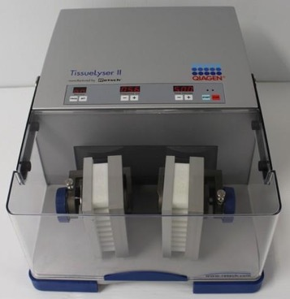
DNA extraction
2
Total DNA extraction = cell lysis followed by DNA isolation
Cell lysis
Mechanical
Chemical/Enzymatic
• Heating
• Freeze/thaw
• Bead-beating
• Detergents
Triton-X-100
• Cell wall disruption
Lysozyme
Mutanolysin
Lysostaphin
• Protein degradation
Proteinase K
• RNA digestion
RNAse A
Intact cells
Isolated DNA
Tissue lyzer II
Bias in cell lysis can severely distort the measured composition
→ “mock community“
Bias
Notes:
http://journals.plos.org/plosone/article?id=10.1371/journal.pone.0163148
Evaluation of Lysis Methods for the Extraction of Bacterial DNA for Analysis of the Vaginal Microbiota
DNA extraction and purification: All biological specimens were first incubated in a preparation of enzymatic lysis buffer (20 mM Tris, pH 8.0, 2 mM EDTA, 1.2% Triton X-100) and lysozyme (20 mg/mL) for 30 minutes at 37°C. The standard protocol for lysing gram-positive
2
bacterial cells of the Invitrogen PureLink Genomic DNA kit (Carlsbad, CA; #K1820-02) was followed for all subsequent steps. Purified genomic DNA was resuspended in 50 μl of PureLink Genomic Elution Buffer and stored at -20°C.
https://www.thermofisher.com/order/catalog/product/K182001
Purelink genomic DNA

Slide 47
Amplify hypervariable regions of interest from 16S gene
16S rRNA secondary structure
16S rRNA contains 9 variable regions
conserved region (non-specific)
variable region (species-specific)
1500 bp
V7
V6
V4
1
2
3
4
5
6
7
8
9
V5
V3
V8
→ Conserved regions serve as universal primer binding sites
→ Variable regions can be used to distinguish organisms at various taxonomic levels
V1
→ More distantly related species exhibit more divergent 16S RNA sequences
How much of the 16S gene do we need to sequence to distinguish between organisms?
V2
Notes:
Figure 2. J Invest Dermatol. 2016 Mar; 136(3): e23–e27. Bacterial 16S ribosomal RNA gene sequencing in cutaneous research. Jay-Hyun Jo, Postdoctoral Fellow, Elizabeth A. Kennedy, Post-baccalaureate Fellow, and Heidi H. Kong, Investigator
http://help.bioiplug.com/16s-rrna-and-16s-rrna-gene/
https://www.illumina.com/documents/products/appnotes/appnote_miseq_16S.pdf
https://www.pacb.com/wp-content/uploads/Jethro-Johnson-PacBio-East-Coast-UGM-2017.pdf

Slide 48
Hypervariable 16S regions can be used for species identification
Example: We are studying a collection of sentences and want to differentiate them and determine how many of each type we have
V1
V2
V3
These sentences have some conserved (e.g. “the” “jump”) and some variable (e.g. (“over/under”) regions
How many variable regions do we need to consider to effectively catalog all 8 sentences
1. The cow jumps over the moon
2. The cow jumps over the moon
3. The cow jumps under the sun
4. The cow jumps under the sun
5. The horse jumps over the moon
6. The horse jumps over the moon
7. The horse jumps over the sun
8. The horse jumps under the sun
48
Notes:
Figure 2. J Invest Dermatol. 2016 Mar; 136(3): e23–e27. Bacterial 16S ribosomal RNA gene sequencing in cutaneous research. Jay-Hyun Jo, Postdoctoral Fellow, Elizabeth A. Kennedy, Post-baccalaureate Fellow, and Heidi H. Kong, Investigator
http://help.bioiplug.com/16s-rrna-and-16s-rrna-gene/
https://www.illumina.com/documents/products/appnotes/appnote_miseq_16S.pdf
https://www.pacb.com/wp-content/uploads/Jethro-Johnson-PacBio-East-Coast-UGM-2017.pdf

Slide 49
Hypervariable 16S regions can be used for species identification
Example: We are studying a collection of sentences and want to differentiate them and determine how many of each type we have
V1
V2
V3
Actual distribution of sentence types
1. The cow jumps over the moon
2. The cow jumps over the moon
8
Legend
3. The cow jumps under the sun
6
COM
CUS
4. The cow jumps under the sun
4
abundance
HOS
5. The horse jumps over the moon
HOM
2
6. The horse jumps over the moon
HUS
7. The horse jumps over the sun
0
Actual
8. The horse jumps under the sun
49
Notes:
Figure 2. J Invest Dermatol. 2016 Mar; 136(3): e23–e27. Bacterial 16S ribosomal RNA gene sequencing in cutaneous research. Jay-Hyun Jo, Postdoctoral Fellow, Elizabeth A. Kennedy, Post-baccalaureate Fellow, and Heidi H. Kong, Investigator
http://help.bioiplug.com/16s-rrna-and-16s-rrna-gene/
https://www.illumina.com/documents/products/appnotes/appnote_miseq_16S.pdf
https://www.pacb.com/wp-content/uploads/Jethro-Johnson-PacBio-East-Coast-UGM-2017.pdf

Slide 50
Hypervariable 16S regions can be used for species identification
Regions
considered
V1
V2
V3
variants
# of variants
1. The cow jumps over the moon
V1
cow, horse
2
2. The cow jumps over the moon
3. The cow jumps under the sun
8
Legend
4. The cow jumps under the sun
6
COM
5. The horse jumps over the moon
CUS
4
6. The horse jumps over the moon
abundance
HOS
7. The horse jumps over the sun
2
HOM
HUS
8. The horse jumps under the sun
0
V1
actual
50
Notes:
Figure 2. J Invest Dermatol. 2016 Mar; 136(3): e23–e27. Bacterial 16S ribosomal RNA gene sequencing in cutaneous research. Jay-Hyun Jo, Postdoctoral Fellow, Elizabeth A. Kennedy, Post-baccalaureate Fellow, and Heidi H. Kong, Investigator
http://help.bioiplug.com/16s-rrna-and-16s-rrna-gene/
https://www.illumina.com/documents/products/appnotes/appnote_miseq_16S.pdf
https://www.pacb.com/wp-content/uploads/Jethro-Johnson-PacBio-East-Coast-UGM-2017.pdf

Slide 51
Hypervariable 16S regions can be used for species identification
Regions
considered
variants
# of variants
V1
V1
cow, horse
2
V2
V3
1. The cow jumps over the moon
V2
over, under
2
2. The cow jumps over the moon
3. The cow jumps under the sun
8
Legend
4. The cow jumps under the sun
6
COM
5. The horse jumps over the moon
CUS
4
6. The horse jumps over the moon
abundance
HOS
7. The horse jumps over the sun
2
HOM
8. The horse jumps under the sun
HUS
0
V1
V2
actual
51
Notes:
Figure 2. J Invest Dermatol. 2016 Mar; 136(3): e23–e27. Bacterial 16S ribosomal RNA gene sequencing in cutaneous research. Jay-Hyun Jo, Postdoctoral Fellow, Elizabeth A. Kennedy, Post-baccalaureate Fellow, and Heidi H. Kong, Investigator
http://help.bioiplug.com/16s-rrna-and-16s-rrna-gene/
https://www.illumina.com/documents/products/appnotes/appnote_miseq_16S.pdf
https://www.pacb.com/wp-content/uploads/Jethro-Johnson-PacBio-East-Coast-UGM-2017.pdf

Slide 52
Hypervariable 16S regions can be used for species identification
Regions
considered
variants
# of variants
V1
cow, horse
2
V1
V2
V3
V2
over, under
2
1. The cow jumps over the moon
cow-over
horse-over
cow-under
horse-under
2. The cow jumps over the moon
V1
4
3. The cow jumps under the sun
V2
4. The cow jumps under the sun
5. The horse jumps over the moon
8
Legend
6. The horse jumps over the moon
6
COM
7. The horse jumps over the sun
4
CUS
abundance
HOS
8. The horse jumps under the sun
2
HOM
HUS
0
V1
V2
V12
actual
Notes:
Figure 2. J Invest Dermatol. 2016 Mar; 136(3): e23–e27. Bacterial 16S ribosomal RNA gene sequencing in cutaneous research. Jay-Hyun Jo, Postdoctoral Fellow, Elizabeth A. Kennedy, Post-baccalaureate Fellow, and Heidi H. Kong, Investigator
http://help.bioiplug.com/16s-rrna-and-16s-rrna-gene/
https://www.illumina.com/documents/products/appnotes/appnote_miseq_16S.pdf
https://www.pacb.com/wp-content/uploads/Jethro-Johnson-PacBio-East-Coast-UGM-2017.pdf

Slide 53
Hypervariable 16S regions can be used for species identification
Regions
considered
variants
# of variants
cow-over-moon
horse-over-moon
horse-over-sun
cow-under-sun
horse-under-sun
V1
V2
V3
V1
1. The cow jumps over the moon
V2
5
2. The cow jumps over the moon
V3
3. The cow jumps under the sun
4. The cow jumps under the sun
8
Legend
5. The horse jumps over the moon
6. The horse jumps over the moon
6
COM
7. The horse jumps over the sun
4
CUS
abundance
HOS
8. The horse jumps under the sun
2
HOM
HUS
The more variable regions considered, the higher the resolution
0
V1
V2
V12
123
actual
Notes:
Figure 2. J Invest Dermatol. 2016 Mar; 136(3): e23–e27. Bacterial 16S ribosomal RNA gene sequencing in cutaneous research. Jay-Hyun Jo, Postdoctoral Fellow, Elizabeth A. Kennedy, Post-baccalaureate Fellow, and Heidi H. Kong, Investigator
http://help.bioiplug.com/16s-rrna-and-16s-rrna-gene/
https://www.illumina.com/documents/products/appnotes/appnote_miseq_16S.pdf
https://www.pacb.com/wp-content/uploads/Jethro-Johnson-PacBio-East-Coast-UGM-2017.pdf

Slide 54
Hypervariable 16S regions can be used for species identification
Regions
considered
variants
# of variants
cow-over-moon
horse-over-moon
horse-over-sun
cow-under-sun
horse-under-sun
V1
V2
V3
V1
1. The cow jumps over the moon
V2
5
2. The cow jumps over the moon
V3
3. The cow jumps under the sun
4. The cow jumps under the sun
8
Legend
5. The horse jumps under the pond
6. The horse jumps over the lake
6
COM
7. The horse jumps over the wood
4
CUS
abundance
HUP
8. The horse jumps over the wood
2
HOL
HOW
But…the exact number of regions you need depends on composition
0
V1
V12
V3
123
actual
Notes:
Figure 2. J Invest Dermatol. 2016 Mar; 136(3): e23–e27. Bacterial 16S ribosomal RNA gene sequencing in cutaneous research. Jay-Hyun Jo, Postdoctoral Fellow, Elizabeth A. Kennedy, Post-baccalaureate Fellow, and Heidi H. Kong, Investigator
http://help.bioiplug.com/16s-rrna-and-16s-rrna-gene/
https://www.illumina.com/documents/products/appnotes/appnote_miseq_16S.pdf
https://www.pacb.com/wp-content/uploads/Jethro-Johnson-PacBio-East-Coast-UGM-2017.pdf

Slide 55
Hypervariable 16S regions can be used for species identification
Phylogenetic resolution is a tradeoff between read length and read depth
→ Different read lengths can be achieved by different sequencing technologies
conserved region (non-specific)
variable region (species-specific)
1500 bp
Length
Resolution
1
2
3
4
5
6
7
8
9
~480 bp
Genus, species
V1-V3
~255 bp
Family, genus
V4
~1500 bp
Species, strain
V1-V9
Notes:
~500 bp (454/MiSeq)
~250 bp (HiSeq)
~1500 bp (PacBio)
Figure 2. J Invest Dermatol. 2016 Mar; 136(3): e23–e27. Bacterial 16S ribosomal RNA gene sequencing in cutaneous research. Jay-Hyun Jo, Postdoctoral Fellow, Elizabeth A. Kennedy, Post-baccalaureate Fellow, and Heidi H. Kong, Investigator
http://help.bioiplug.com/16s-rrna-and-16s-rrna-gene/
https://www.illumina.com/documents/products/appnotes/appnote_miseq_16S.pdf
https://www.pacb.com/wp-content/uploads/Jethro-Johnson-PacBio-East-Coast-UGM-2017.pdf

Slide 56

16S Amplification occurs in 2 steps
→ We want to amplify copies of the 16S gene from our patient metagenomes so we have enough material for sequencing
1
PCR
very sensitive
error prone
2
Clone into bacteria
Huge amplification
High fidelity
Requires starting material
Notes:
Oh et al. Genome Medicine, 2012, 4:77

Slide 57
Sequence processing
5
Processing and QC of reads: base calling & trimming
trim
Remove (i) chimeras and (ii) sequences that align to the human genome (E<0.1)
Notes:
Oh et al. Genome Medicine, 2012, 4:77
ErrorCumulative = (∑10-Qi/10) / L, where Qi = Phred score at position i; L = sequence length The resulting assemblies and quality data were stored in an Oracle database along with descriptive data for each sample. Sequences were further screened against the human genome, classified using the RDP classifier (4), aligned using the Greengenes (5) NAST aligner (6) and chimera checked using the implementation of Bellerophon (v.3) at Greengenes (7) using default parameters. Sequences were omitted from further analysis if they had a cumulative error >0.02; or matched the human genome (E-value < 0.1); or were less than 1,250 base pairs long; or were flagged as putative chimeras. A total of 168,524 assemblies were generated. Of those, 1,679 were putative chimeras, 7,767 were short or were homologous to human sequence, and 32,161 were of low quality using the above standards. Sequences were assigned to taxonomy using the Ribosomal Database Project (RDP) naïve Bayesian classifier (8). A residual group of 187 non- chimeric sequences were unclassifiable.

Slide 58
Read assembly for each clone
There are three sequencing reads for each clone
Read 1
Quality score
Read 2
Read 3
Assembled read
Notes:
Oh et al. Genome Medicine, 2012, 4:77
ErrorCumulative = (∑10-Qi/10) / L, where Qi = Phred score at position i; L = sequence length The resulting assemblies and quality data were stored in an Oracle database along with descriptive data for each sample. Sequences were further screened against the human genome, classified using the RDP classifier (4), aligned using the Greengenes (5) NAST aligner (6) and chimera checked using the implementation of Bellerophon (v.3) at Greengenes (7) using default parameters. Sequences were omitted from further analysis if they had a cumulative error >0.02; or matched the human genome (E-value < 0.1); or were less than 1,250 base pairs long; or were flagged as putative chimeras. A total of 168,524 assemblies were generated. Of those, 1,679 were putative chimeras, 7,767 were short or were homologous to human sequence, and 32,161 were of low quality using the above standards. Sequences were assigned to taxonomy using the Ribosomal Database Project (RDP) naïve Bayesian classifier (8). A residual group of 187 non- chimeric sequences were unclassifiable.

Slide 59
Where do we want to go next?
Processed 16S sequences
microbial
composition
Extraction
Sequencing
?
…
The challenge of metagenomics is that the sample is mixed!
Which 16S sequence came from which bacterium?
Does every unique 16S sequence come from a unique microbe?
Notes:
Collapse related amplicons into OTUs
OTU = operational taxonomic unit
Generally assumed to mean sequences <3% divergent are collapsed into a single representative
Corresponds approximately to species
Allows reference-independent comparison of taxonomic richness
As discussed in Section 4, sequence-based analysis assumes that taxonomic (or biologically
relevant?) differences between bacteria are reflected by differences in their 16S gene sequence.
But how much do two 16S gene sequences have to differ before they represent two distinct bacterial
strains, species, or even genera? There is a discussion of this issue on the USEARCH
[website][usearch-definingotus].
In this practical session the goal is to identify and quantify distinct bacterial species.
Assuming that a certain amount of 16S gene sequence variation exists within species (different
bacterial strains?) we will generate operational taxonomic units (OTUs) based on the assumption
that two sequences which are more than 97% similar belong to the same species.

Slide 60
It is trivial to catalog identical objects
mixed sample
cataloged
Notes:
Collapse related amplicons into OTUs
OTU = operational taxonomic unit
Generally assumed to mean sequences <3% divergent are collapsed into a single representative
Corresponds approximately to species
Allows reference-independent comparison of taxonomic richness
As discussed in Section 4, sequence-based analysis assumes that taxonomic (or biologically
relevant?) differences between bacteria are reflected by differences in their 16S gene sequence.
But how much do two 16S gene sequences have to differ before they represent two distinct bacterial
strains, species, or even genera? There is a discussion of this issue on the USEARCH
[website][usearch-definingotus].
In this practical session the goal is to identify and quantify distinct bacterial species.
Assuming that a certain amount of 16S gene sequence variation exists within species (different
bacterial strains?) we will generate operational taxonomic units (OTUs) based on the assumption
that two sequences which are more than 97% similar belong to the same species.

Slide 61
Cataloging variable objects is hard
mixed
sample
Notes:
Collapse related amplicons into OTUs
OTU = operational taxonomic unit
Generally assumed to mean sequences <3% divergent are collapsed into a single representative
Corresponds approximately to species
Allows reference-independent comparison of taxonomic richness
As discussed in Section 4, sequence-based analysis assumes that taxonomic (or biologically
relevant?) differences between bacteria are reflected by differences in their 16S gene sequence.
But how much do two 16S gene sequences have to differ before they represent two distinct bacterial
strains, species, or even genera? There is a discussion of this issue on the USEARCH
[website][usearch-definingotus].
In this practical session the goal is to identify and quantify distinct bacterial species.
Assuming that a certain amount of 16S gene sequence variation exists within species (different
bacterial strains?) we will generate operational taxonomic units (OTUs) based on the assumption
that two sequences which are more than 97% similar belong to the same species.

Slide 62
Cataloging variable objects is hard
*
*
mixed
sample
*
*
Intuitively we know that the starred pictures are all pears….but how would we approach this if we knew nothing about fruit?
Notes:
Collapse related amplicons into OTUs
OTU = operational taxonomic unit
Generally assumed to mean sequences <3% divergent are collapsed into a single representative
Corresponds approximately to species
Allows reference-independent comparison of taxonomic richness
As discussed in Section 4, sequence-based analysis assumes that taxonomic (or biologically
relevant?) differences between bacteria are reflected by differences in their 16S gene sequence.
But how much do two 16S gene sequences have to differ before they represent two distinct bacterial
strains, species, or even genera? There is a discussion of this issue on the USEARCH
[website][usearch-definingotus].
In this practical session the goal is to identify and quantify distinct bacterial species.
Assuming that a certain amount of 16S gene sequence variation exists within species (different
bacterial strains?) we will generate operational taxonomic units (OTUs) based on the assumption
that two sequences which are more than 97% similar belong to the same species.

Slide 63
We catalog variable objects by iterative pairwise comparison
mixed
sample
1
3
ranked
pairwise comparisons
2
4
Notes:
Collapse related amplicons into OTUs
OTU = operational taxonomic unit
Generally assumed to mean sequences <3% divergent are collapsed into a single representative
Corresponds approximately to species
Allows reference-independent comparison of taxonomic richness
As discussed in Section 4, sequence-based analysis assumes that taxonomic (or biologically
relevant?) differences between bacteria are reflected by differences in their 16S gene sequence.
But how much do two 16S gene sequences have to differ before they represent two distinct bacterial
strains, species, or even genera? There is a discussion of this issue on the USEARCH
[website][usearch-definingotus].
In this practical session the goal is to identify and quantify distinct bacterial species.
Assuming that a certain amount of 16S gene sequence variation exists within species (different
bacterial strains?) we will generate operational taxonomic units (OTUs) based on the assumption
that two sequences which are more than 97% similar belong to the same species.

Slide 64
We catalog variable objects by iterative pairwise comparison
mixed
sample
1
3
ranked
pairwise comparisons
2
4
Notes:
Collapse related amplicons into OTUs
OTU = operational taxonomic unit
Generally assumed to mean sequences <3% divergent are collapsed into a single representative
Corresponds approximately to species
Allows reference-independent comparison of taxonomic richness
As discussed in Section 4, sequence-based analysis assumes that taxonomic (or biologically
relevant?) differences between bacteria are reflected by differences in their 16S gene sequence.
But how much do two 16S gene sequences have to differ before they represent two distinct bacterial
strains, species, or even genera? There is a discussion of this issue on the USEARCH
[website][usearch-definingotus].
In this practical session the goal is to identify and quantify distinct bacterial species.
Assuming that a certain amount of 16S gene sequence variation exists within species (different
bacterial strains?) we will generate operational taxonomic units (OTUs) based on the assumption
that two sequences which are more than 97% similar belong to the same species.

Slide 65
Clusters arise of similar items
mixed
sample
ranked
pairwise comparisons
Notes:
Collapse related amplicons into OTUs
OTU = operational taxonomic unit
Generally assumed to mean sequences <3% divergent are collapsed into a single representative
Corresponds approximately to species
Allows reference-independent comparison of taxonomic richness
As discussed in Section 4, sequence-based analysis assumes that taxonomic (or biologically
relevant?) differences between bacteria are reflected by differences in their 16S gene sequence.
But how much do two 16S gene sequences have to differ before they represent two distinct bacterial
strains, species, or even genera? There is a discussion of this issue on the USEARCH
[website][usearch-definingotus].
In this practical session the goal is to identify and quantify distinct bacterial species.
Assuming that a certain amount of 16S gene sequence variation exists within species (different
bacterial strains?) we will generate operational taxonomic units (OTUs) based on the assumption
that two sequences which are more than 97% similar belong to the same species.

Slide 66
Similar fruits cluster together
mixed
sample
pairwise comparison
distances
orange
pear
apple
Notes:
Collapse related amplicons into OTUs
OTU = operational taxonomic unit
Generally assumed to mean sequences <3% divergent are collapsed into a single representative
Corresponds approximately to species
Allows reference-independent comparison of taxonomic richness
As discussed in Section 4, sequence-based analysis assumes that taxonomic (or biologically
relevant?) differences between bacteria are reflected by differences in their 16S gene sequence.
But how much do two 16S gene sequences have to differ before they represent two distinct bacterial
strains, species, or even genera? There is a discussion of this issue on the USEARCH
[website][usearch-definingotus].
In this practical session the goal is to identify and quantify distinct bacterial species.
Assuming that a certain amount of 16S gene sequence variation exists within species (different
bacterial strains?) we will generate operational taxonomic units (OTUs) based on the assumption
that two sequences which are more than 97% similar belong to the same species.

Slide 67
Where do we want to go next?
Assembled and pooled 16S reads across samples
Swab site
composition
Extraction
Sequencing
?
…
1
Identify unique
sequences
2
Use pairwise comparison to cluster into operational taxonomic units (OTUs)
3
Count how many sequences match each OTU
Notes:
Collapse related amplicons into OTUs
OTU = operational taxonomic unit
Generally assumed to mean sequences <3% divergent are collapsed into a single representative
Corresponds approximately to species
Allows reference-independent comparison of taxonomic richness
As discussed in Section 4, sequence-based analysis assumes that taxonomic (or biologically
relevant?) differences between bacteria are reflected by differences in their 16S gene sequence.
But how much do two 16S gene sequences have to differ before they represent two distinct bacterial
strains, species, or even genera? There is a discussion of this issue on the USEARCH
[website][usearch-definingotus].
In this practical session the goal is to identify and quantify distinct bacterial species.
Assuming that a certain amount of 16S gene sequence variation exists within species (different
bacterial strains?) we will generate operational taxonomic units (OTUs) based on the assumption
that two sequences which are more than 97% similar belong to the same species.

Slide 68
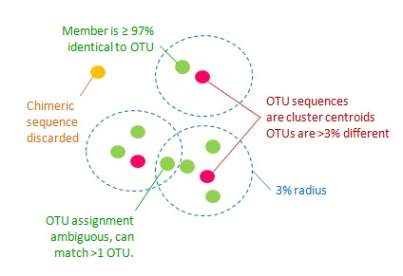
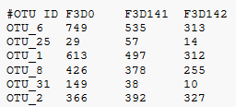
Sequences to OTUs to OTU abundance
OTU sequences are representative sequences chosen for each OUT and are <97% similar compared to any other OTU sequence
~3% similarity = species
Edgar, R.C. Nature Methods (2013) (UPARSE)
To generate a relative abundance table, count the number of 16S sequences matching each OUT sequence
Samples
Counts
OTUs
Notes:
Oh et al:
Remove human genome sequences (E value < 0.1)
Remove chimeras with UCHIME
Assign to taxonomy with RDP classifier
OTUs defined at 97% similarity and clustered with Mothur

Slide 69
How can we visualize this data? 3) What kind of biological insights can we derive?
Notes:
Oh et al:
Remove human genome sequences (E value < 0.1)
Remove chimeras with UCHIME
Assign to taxonomy with RDP classifier
OTUs defined at 97% similarity and clustered with Mothur

Slide 70
Visualizing the OTU table: relative abundance plot
Samples
The Ribosomal Database Project (RDP) Classifier tool identifies OTU taxonomy from a reference database
+
OTUs
+
Notes:
Oh et al:
Remove human genome sequences (E value < 0.1)
Remove chimeras with UCHIME
Assign to taxonomy with RDP classifier
OTUs defined at 97% similarity and clustered with Mothur

Slide 71
Relative abundance plot captures variation in abundance across samples
“we found that the microbial communities clustered into two distinct groups in which those of Tanner stages 1, 2, and 3 differed significantly from those of Tanner stages 4 and 5”
Notes:
Oh et al:
Remove human genome sequences (E value < 0.1)
Remove chimeras with UCHIME
Assign to taxonomy with RDP classifier
OTUs defined at 97% similarity and clustered with Mothur

Slide 72
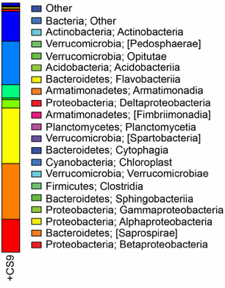
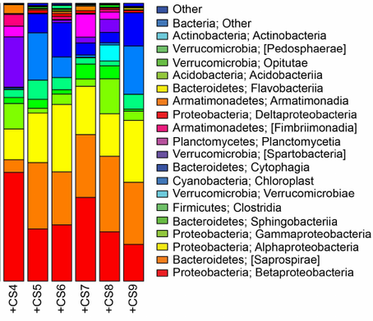
Visualizing diversity: alpha v beta
Alpha diversity: Complexity of community within a given sample
Beta diversity: Variation in microbial communities across samples
“To assess whether there is a shift in the microbial composition of children (Tanner stage 1) versus adults (Tanner stage 5), we calculated the variation between individuals within and between the two groups.”

Slide 73
Visualizing diversity: alpha v beta
Alpha diversity: Complexity of community within a given sample
“decreas[ing alpha diversity] with increasing sexual maturity suggests a stabilization and convergence of the nares microbiome in more mature individuals”
Many methods: Shannon, Simpson, Fisher, etc

Slide 74
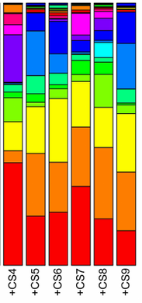
Visualizing diversity: alpha v beta
Beta diversity: Variation in microbial communities across samples
Bray-Curtis dissimilarity: quantifies how much compositional variation exists between pair of samples
A Bray-Curtis = 0 → samples are identical.
A Bray-Curtis = 1 → no OTUs found in common.
→ Visualize by Principle Coordinates Analysis ordination plot

Slide 75
Visualizing diversity: alpha v beta
Beta diversity
“we observed that the microbial community memberships and structures of individuals of Tanner stages 2 and 3 trended towards more significantly resembling those of Tanner stage 1 than later stages…Physiologically, Tanner 4 individuals more closely resemble Tanner 5 individuals in terms of sexual maturity”

Slide 76
16S is powerful, but has limitations
• Phylogenetic classification is limited → Many OTUs are unclassified
 | Phylum | Class | Order | Family | Genus
OTU_1 | Bacteroidetes | Bacteroidia | Bacteroidales | Porphyromonadaceae | unclassified_Porphyromonadaceae
OTU_2 | Firmicutes | Clostridia | Clostridiales | unclassified_Clostridiales | unclassified_Clostridiales
OTU_3 | Firmicutes | Erysipelotrichia | Erysipelotrichales | Erysipelotrichaceae | Clostridium_XVIII
OTU_4 | Firmicutes | Clostridia | Clostridiales | unclassified_Clostridiales | unclassified_Clostridiales
OTU_5 | Bacteroidetes | Bacteroidia | Bacteroidales | Porphyromonadaceae | unclassified_Porphyromonadaceae
OTU_6 | Firmicutes | Clostridia | Clostridiales | Clostridiales_Incertae Sedis XIII | unclassified_Clostridiales_Incertae_Sedis_XIII
• 16S gene is only a single gene → biological insight is limited
Metagenomic shotgun sequencing looks at ALL the DNA, not just 16S
• Better phylogenetic classification → strain level identification (Marker gene analysis)
• All the gene content → functional insight (biosynthetic genes, resistance genes, etc)

Slide 77
Thank you
Julia Oh
Jethro Johnson
Mark Adams

Slide 78
Synthesis: hands-on exercise

Slide 79
A workflow for 16S analysis
1
Collect sample
(e.g. skin swab)
2
Total DNA
extraction
3
Amplify variable region
of 16S rRNA gene
V4
Sequence 16S
rRNA genes
Processing, QC, and assembly
of reads
Generate a representative sequence for each species and assign taxonomy
4
5
6
Read 1
Read 2
7
relative abundance plot
diversity plot
Who? How much?
abundance
diversity
healthy
diseased
healthy
diseased
Notes:
http://learn.genetics.utah.edu/content/microbiome/intro/
https://www.theatlantic.com/technology/archive/2012/11/what-dna-actually-looks-like/265713/

Slide 80
A microbiome module by design
Conceptual goals for students
• why do we sequence the 16S gene?
• how do we decide which 16S sequences belong to which organism?
• what can relative abundance and diversity plots tell us?
• develop hypothesis and test it
Data science goals for students
• file manipulation from the command line
• writing and executing ”for loops”
• running commands in terminal
• data visualization in R
• writing R notebooks

Slide 81
A microbiome module by design
Teaching implementation goals
• allows for individual student curiosity & open-endedness
• real-world medical relevance
• easily sourced raw data
• do not have to wait for code to run
• avoid painful coding “typos”
• avoid version/compatibility issues

Slide 82
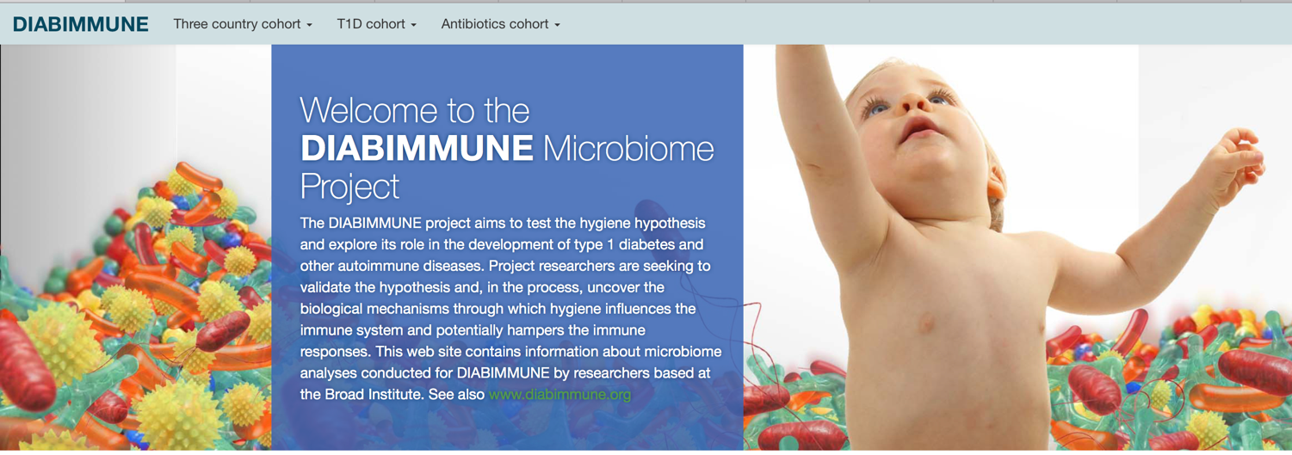
The exercise: an overview
“What is the role of the microbiome and the “hygiene hypothesis” in the development of type 1 diabetes and other auto-immune diseases?”
https://pubs.broadinstitute.org/diabimmune

Slide 83
The exercise: an overview
“The goal of this cohort is to compare microbiome in infants who have developed type 1 diabetes (T1D) or serum autoantibodies (markers predicting the onset of T1D) with healthy controls in the same area.”

Slide 84
The exercise: an overview
Command line
review
metaseqR
phyloseq
usearch
relative abundance table
Diab-
immune
OTU count table
linux
FLASh
usearch
usearch
source raw 16S reads
prepare reads for analysis
combine paired reads
identify unique AND n>1,
sequences
alpha diversity
plot
cluster OTUs
assign taxonomy
beta diversity plot
rdp
classifier
Notes:
NOTES:
Tab to complete
Have everyone watch me first and THEN try on machine

Slide 85
The exercise: an overview
Command line
review
metaseqR
phyloseq
usearch
relative abundance table
Diab-
immune
OTU count table
linux
FLASh
usearch
usearch
source raw 16S reads
prepare reads for analysis
combine paired reads
identify unique AND n>1,
sequences
alpha diversity
plot
cluster OTUs
assign taxonomy
• choose files
• download files
• uncompress files
beta diversity plot
rdp
classifier

Slide 86
The exercise: an overview
Command line
review
metaseqR
phyloseq
usearch
relative abundance table
Diab-
immune
OTU count table
linux
FLASh
usearch
usearch
source raw 16S reads
prepare reads for analysis
combine paired reads
identify unique AND n>1,
sequences
alpha diversity
plot
cluster OTUs
assign taxonomy
• rename files case/control
• create symbolic links
• take a peak at the data
beta diversity plot
rdp
classifier

Slide 87
The exercise: an overview
Command line
review
metaseqR
phyloseq
usearch
relative abundance table
Diab-
immune
OTU count table
linux
FLASh
usearch
usearch
source raw 16S reads
prepare reads for analysis
combine paired reads
identify unique AND n>1,
sequences
alpha diversity
plot
cluster OTUs
assign taxonomy
• pair reads with for loop
• convert fastq to fasta
beta diversity plot
rdp
classifier

Slide 88
The exercise: an overview
Command line
review
metaseqR
phyloseq
usearch
relative abundance table
Diab-
immune
OTU count table
linux
FLASh
usearch
usearch
source raw 16S reads
prepare reads for analysis
combine paired reads
identify unique AND n>1,
sequences
alpha diversity
plot
cluster OTUs
assign taxonomy
• pool all samples
• remove duplicates
• remove singletons
beta diversity plot
rdp
classifier

Slide 89
The exercise: an overview
Command line
review
metaseqR
phyloseq
usearch
relative abundance table
Diab-
immune
OTU count table
linux
FLASh
usearch
usearch
source raw 16S reads
prepare reads for analysis
combine paired reads
identify unique AND n>1,
sequences
alpha diversity
plot
cluster OTUs
assign taxonomy
• cluster pooled seqs > OTUs
• relabel OTUs for ease
beta diversity plot
rdp
classifier

Slide 90
The exercise: an overview
Command line
review
metaseqR
phyloseq
• match sample reads to OTUs
• count how many times each OTU got a match
usearch
relative abundance table
Diab-
immune
OTU count table
linux
FLASh
usearch
usearch
source raw 16S reads
prepare reads for analysis
combine paired reads
identify unique AND n>1,
sequences
alpha diversity
plot
cluster OTUs
assign taxonomy
• assign taxonomy for each OTU
beta diversity plot
rdp
classifier

Slide 91
The exercise: an overview
Command line
review
metaseqR
phyloseq
usearch
relative abundance table
Diab-
immune
OTU count table
linux
FLASh
usearch
usearch
source raw 16S reads
prepare reads for analysis
combine paired reads
identify unique AND n>1,
sequences
alpha diversity
plot
cluster OTUs
assign taxonomy
beta diversity plot
rdp
classifier

Slide 92
Revisiting our goals
Conceptual goals for students
• why do we sequence the 16S gene?
• how do we decide which 16S sequences belong to which organism?
• what can relative abundance and diversity plots tell us?
• develop hypothesis and test it
Data science goals for students
• file manipulation from the command line
• writing and executing ”for loops”
• running commands in terminal
• data visualization in R
• writing R notebooks

Slide 93
Revisiting our goals
Teaching implementation goals
• allows for individual student curiosity & open-endedness
• real-world medical relevance
• easily sourced raw data
• do not have to wait for code to run
• avoid painful coding “typos”
• avoid version/compatibility issues

